Slide 1

Detection of Forest Fire Combustion using IBM Watson Studio
By—
M Harshith Reddy
P Sahith Reddy
S Sriram Chary
V Sumanth Kumar Reddy
A Karthikeya

Slide 2

Forest fires are a major environmental issue, creating economic and ecological damage while endangering human lives. There are typically about 100,000 wildfires in the United States every year. Over 9 million acres of land have been destroyed due to treacherous wildfires. It is difficult to predict and detect Forest Fire in a sparsely populated forest area and it is more difficult if the prediction is done using ground-based methods like Camera or Video-Based approach. Satellites can be an important source of data prior to and also during the Fire due to its reliability and efficiency. The various real-time forest fire detection and prediction approaches, with the goal of informing the local fire authorities.

Slide 3

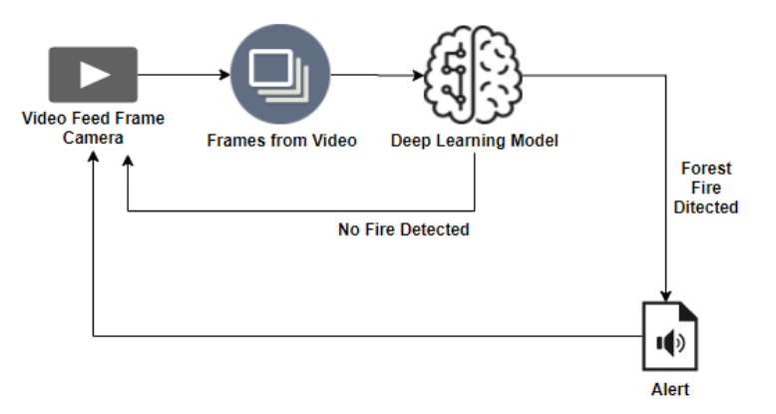
Architecture / block diagram

Slide 4
Image Processing
Image pre-processing includes the following 3 tasks:
Import ImageDataGenerator Library
Configure ImageDataGenerator Class
Applying ImageDataGenerator functionality to the train set and test set

Slide 5
Import ImageDataGenerator Library-
The first step is usually importing the libraries that will be needed in the program.
Import Keras library from that library import the ImageDataGenerator Library to your Python script
Define The Parameters /Arguments For ImageDataGenerator Class-
Image shifts via the width_shift_range and height_shift_range arguments.
Image flips via the horizontal_flip and vertical_flip arguments.
Image rotations via the rotation_range argument
Image brightness via the brightness_range argument.
Image zoom via the zoom_range argument.
We can pass many other arguments inside the ImageDataGenerator Class.

Slide 6
Applying ImageDataGenerator Functionality To Trainset And Test set-
The ImageDataGenerator class has three methods flow (), flow_from_directory ( ), and flow_from_dataframe ( ) to read the images from a big numpy array and folders containing images.
The directory must be set to the path where your training folders are present.
The target_size is the size of your input images, every image will be resized to this size.
batch_size: No. of images to be yielded from the generator per batch.
“batch_size” in both train and test generators is to some number that divides your total number of images in your train set and train set respectively.
class_mode: Set “binary” if you have only two classes to predict, if not set to “categorical”.

Slide 7
Model Building
The neural network model is to be built by adding different network layers like convolution, pooling, flattening, dropout and neural layers
In this milestone, we start building our model by:
1.Initializing the mode
2.Adding Convolution layers
3. Adding Pooling layers
4.Flatten layer
5.Full connection layers which include hidden layers

Slide 8
Initializing The Model-
The Sequential class is used to define linear initializations of network layers which then, collectively, constitute a model. In our example below, we will use the Sequential constructor to create a model, which will then have layers added to it using the add () method

Slide 9
Task 1- Adding CNN layers
1 Adding Convolutional Layers
The convolutional layer is the first and core layer of CNN. It is one of the building blocks of a CNN and is used for extracting important features from the image
In the Convolution operation, the input image will be convolved with the feature detector/filters to get a feature map
In the convolution2D function, we gave arguments that include 32,(3,3), that refers to we are applying 32 filters of 3x3 matrix filter, and input_shape is the input image shape with RGB, here 128x128 is the size and 3 represent the channel, RGB color images
Activation Function-
These are the functions that help us to decide if we need to activate the node or not. These functions introduce non-linearity in the networks

Slide 10
Task 2- Adding Pooling layers
Max Pooling selects the maximum element from the region of the feature map covered by the filter. Thus, the output after max-pooling layer would be a feature map containing the most prominent features of the previous feature map
After the convolution layer, a pooling layer is added. Max pooling layer can be added using MaxPooling2D class. It takes the pool size as a parameter. Efficient size of the pooling matrix is (2,2). It returns the pooled feature maps
Task 3- Adding Flatten layers
Now the pooled feature map from the pooling layer will be converted into one single dimension matrix or map, where each pixel in one single column, nothing but flattening. The flattening layer converts the multi-dimension matrix to one single dimension layer

Slide 11
Adding Dense Layers
Task 1- Adding Convolutional Layers
This step is to add a dense layer (hidden layer). We flatten the feature map and convert it into a vector or single dimensional array in the Flatten layer
Key terms-
init is the weight initialization; initialization function is the network initialization function which sets all the weights and biases of a network to values suitable as a starting point for training.
Units, which denotes is the number of neurons in the hidden layer.
Activation function defines the output of input or set of inputs or in other terms defines node of the output of node that is given in inputs. They basically decide to deactivate neurons or activate them to get the desired output. It also performs a nonlinear transformation on the input to get better results on a complex neural network. Its nodes here just pass on the information (features) to the hidden layer

Slide 12
Task 2- Adding Output Layers
This step is to add a dense layer (output layer) where you will be specifying the number of classes your dependent variable has, activation function and weight initializer as the arguments. We use add () method to add dense layers
Note:
If you have only one or two class in output put “output_dim = 1” and “activation = sigmoid”. If you have more number of classes for supposing there are 3 classes then put “output_dim = 3” and “activation = softmax”

Slide 13
Configuring The Learning Process
With both the training data defined and model defined, it's time to configure the learning process. This is accomplished with a call to the compile () method of the Sequential model class
Training The Model-
The arguments are the batch size as you are using “adam” (bath gradient descent and epochs: no: of times the model should get trained)
steps_per_epoch: It specifies the total number of steps taken from the generator as soon as one epoch is finished and the next epoch has started. We can calculate the value of steps_per_epoch as the total number of samples in your training folder divided by the batch size

Slide 14
Epochs: an integer and number of epochs we want to train our model for
Validation_data: can be either input and targets list generator inputs, targets, and sample_weights list which can be used to evaluate
Validation_steps:
Only if the validation_data is a generator then only this argument can be used. It specifies the total number of steps taken from the generator before it is stopped at every epoch and its value is calculated as the total number of validation data points in your dataset divided by the validation batch size

Slide 15
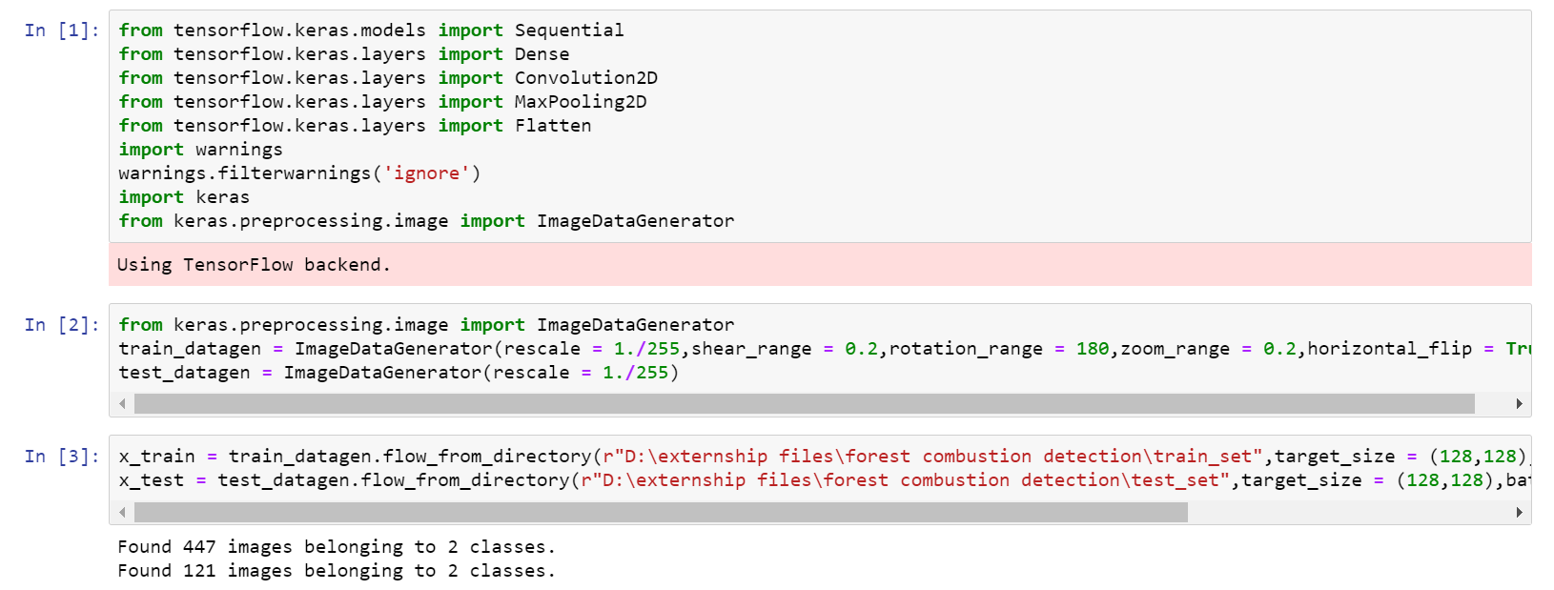

Slide 16
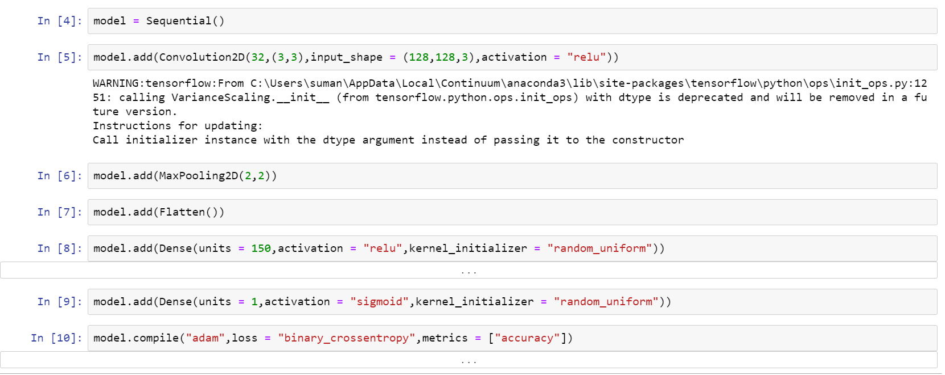

Slide 17
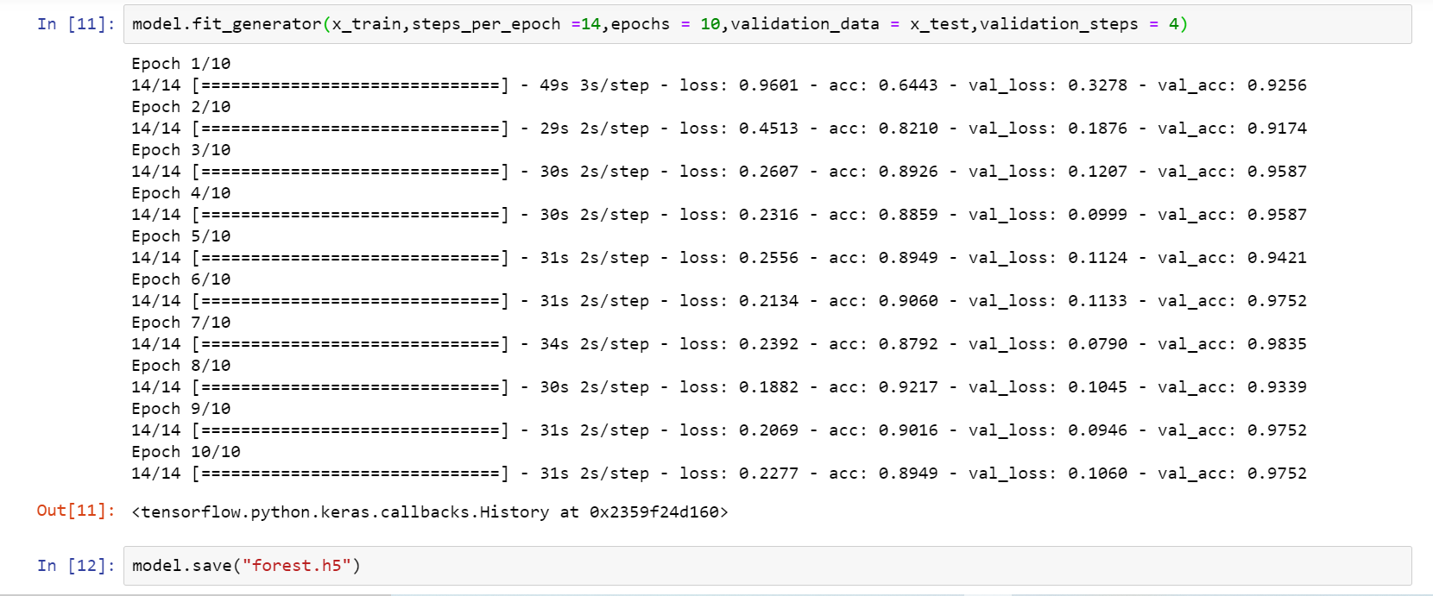

Slide 18
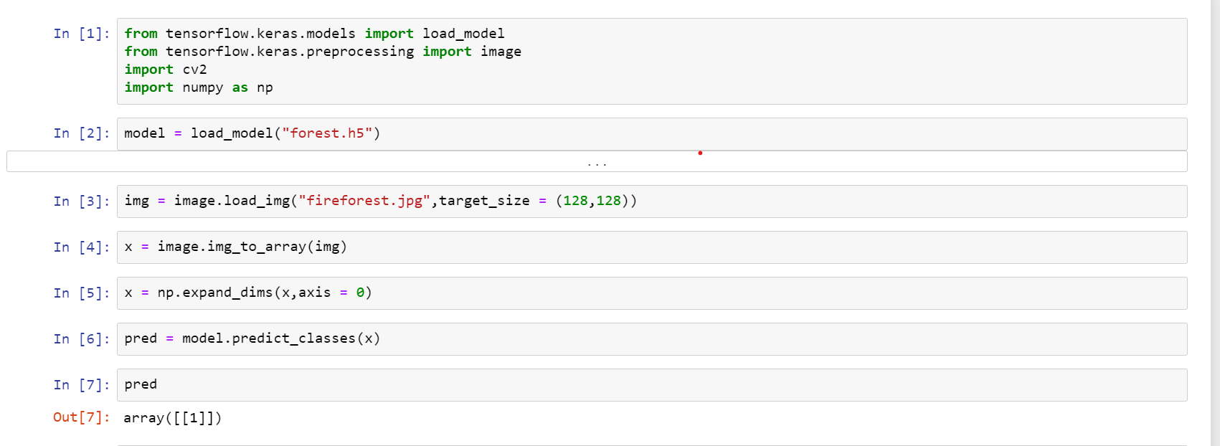
Predictions-

Slide 19
Video Analysis
OpenCV For Video Processing-
OpenCV is an open-source library that provides us with the tools to perform almost any kind of image and video processing
Task 1: Capture Video from Camera
Often, we have to capture the live stream with a camera. OpenCV provides a very simple interface to this
To capture a video, you need to create a Video Capture object. Its argument can be either the device index or the name of a video file. The device index is just the number to specify which camera

Slide 20
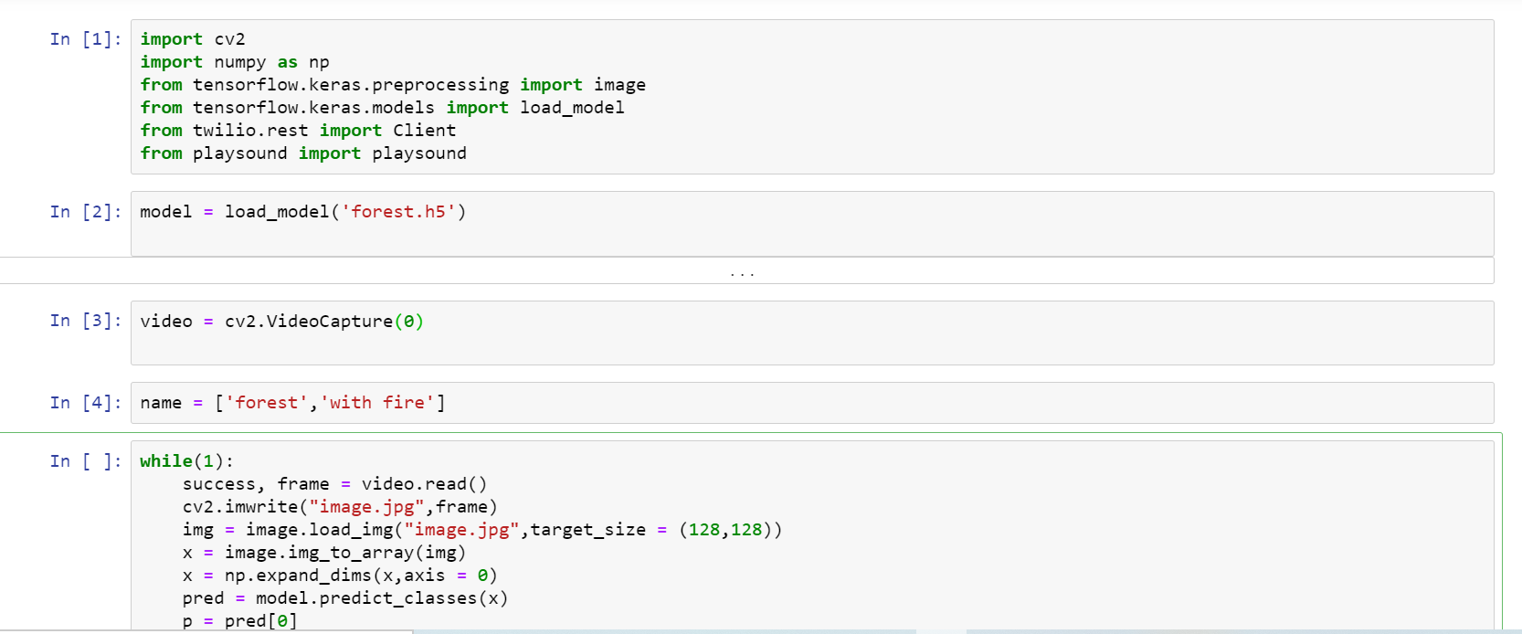

Slide 21
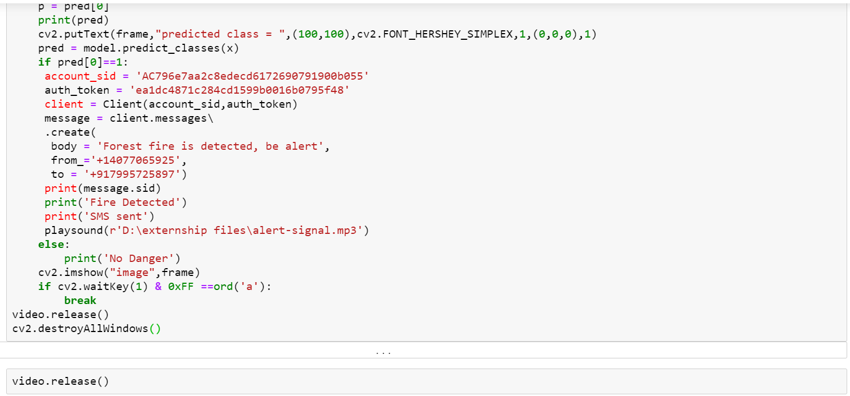

Slide 22
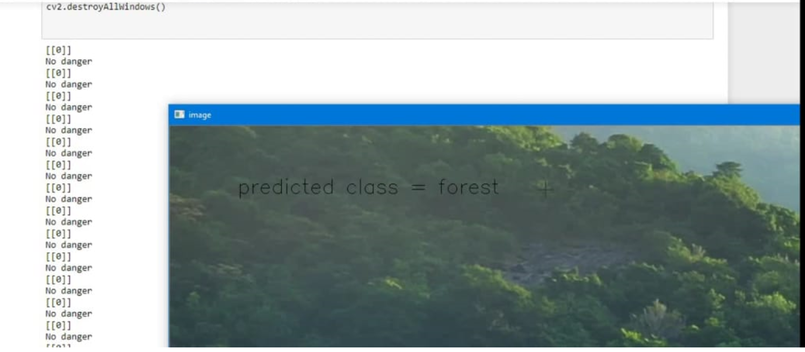
Output-

Slide 23
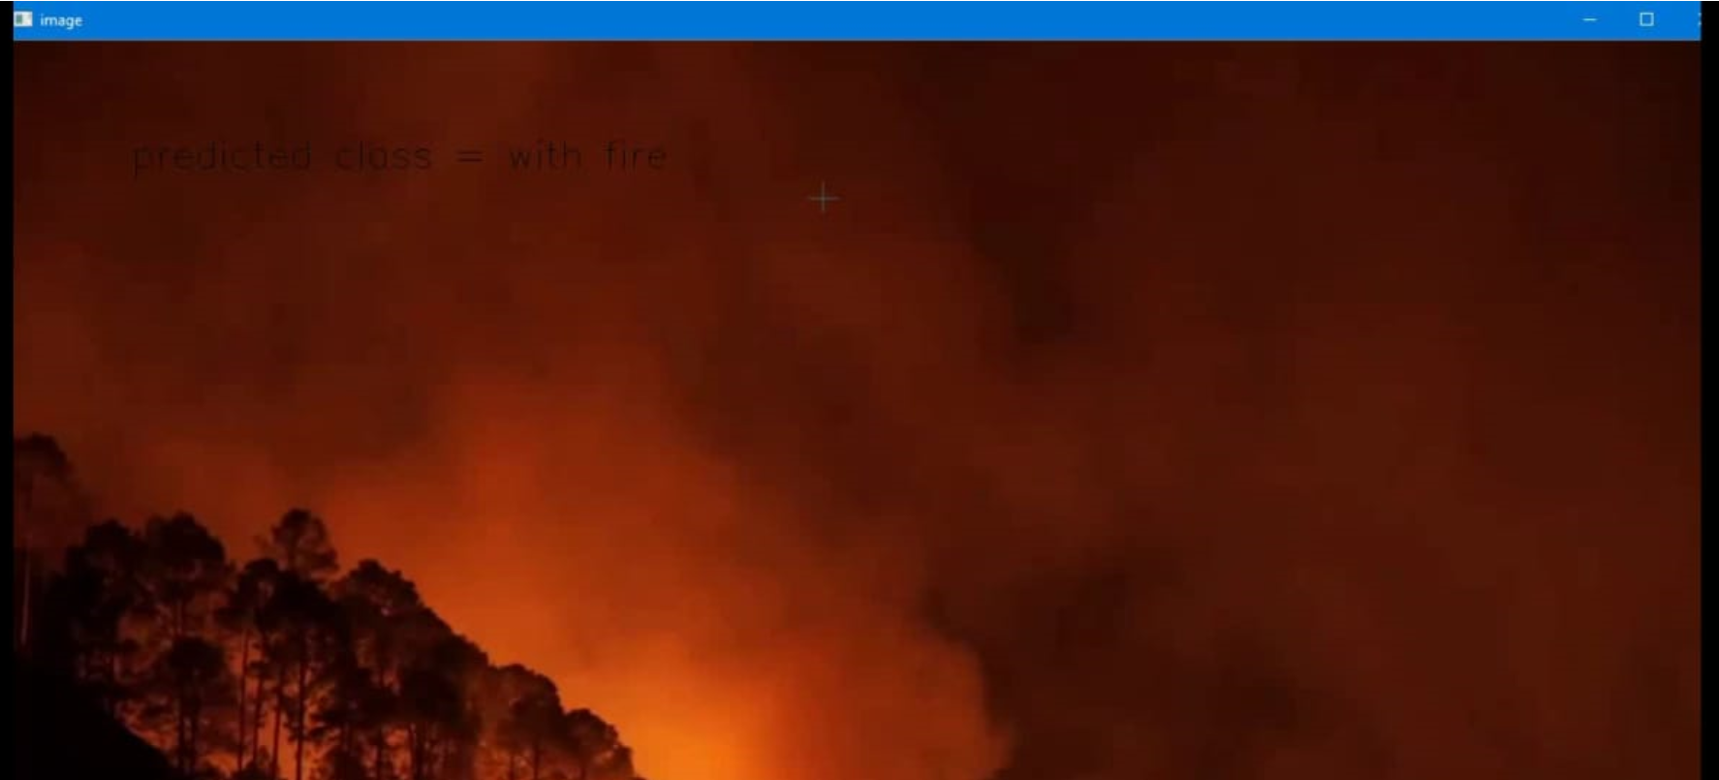
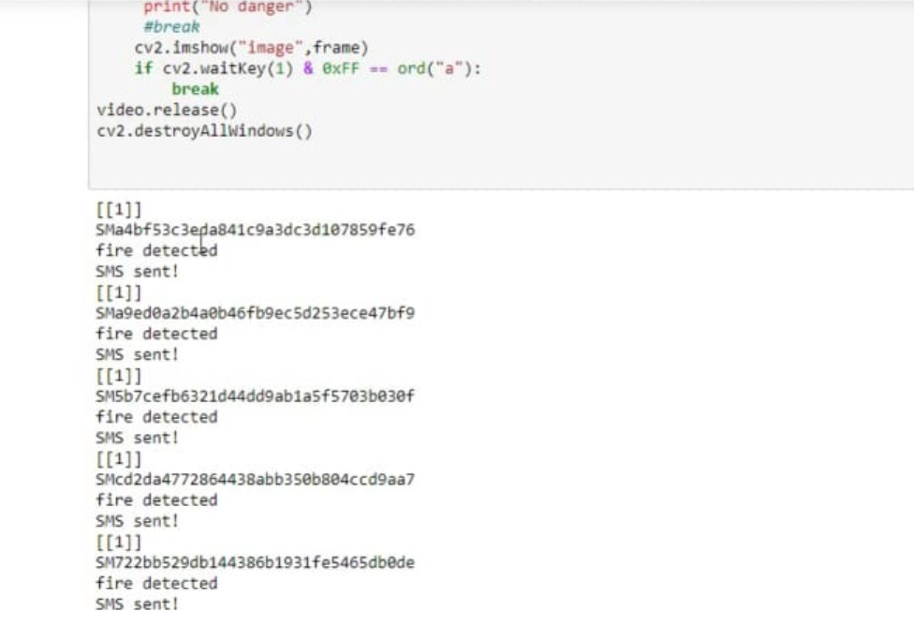

Slide 24
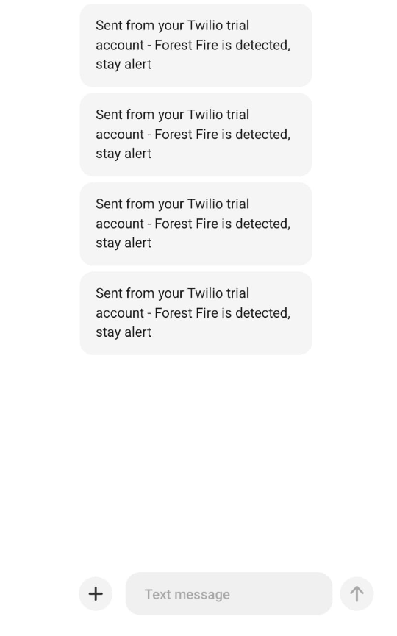
Sending Alert Message (SMS) to IoT Device

Slide 25
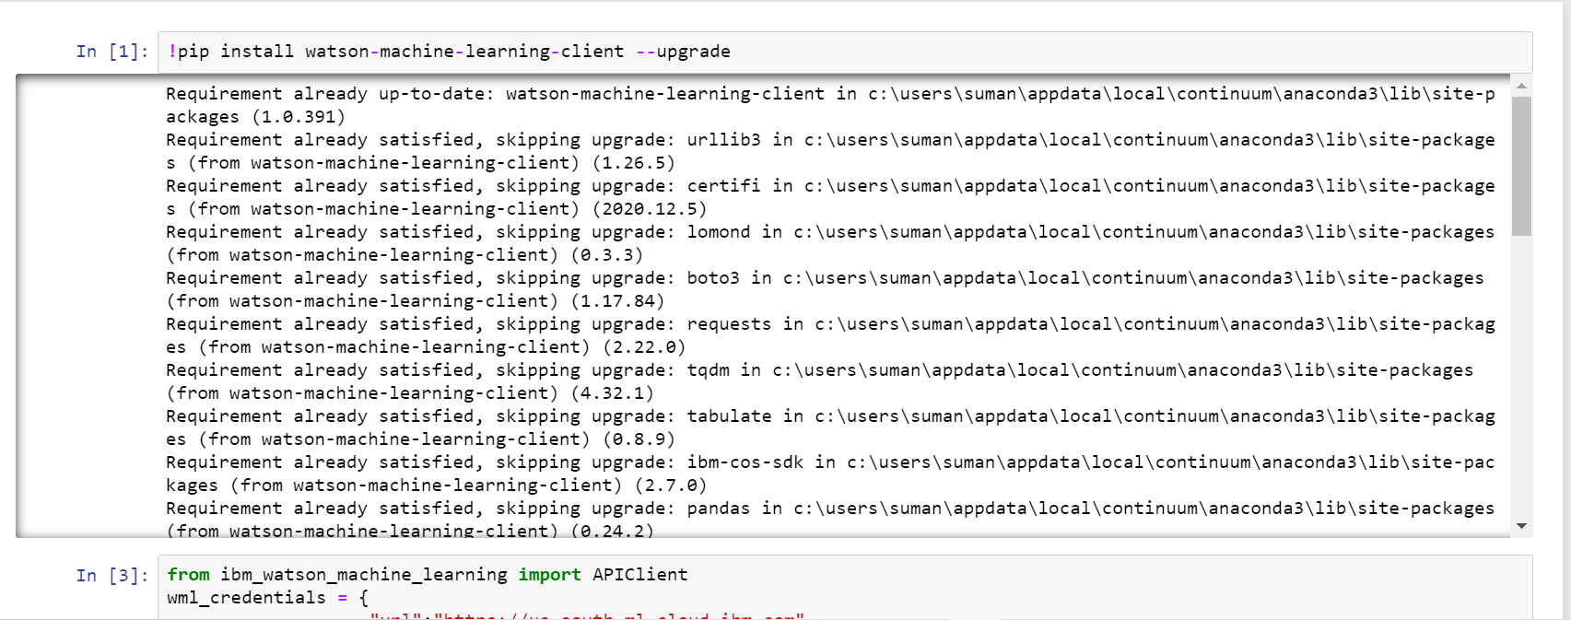
Training CNN Model On IBM-

Slide 26
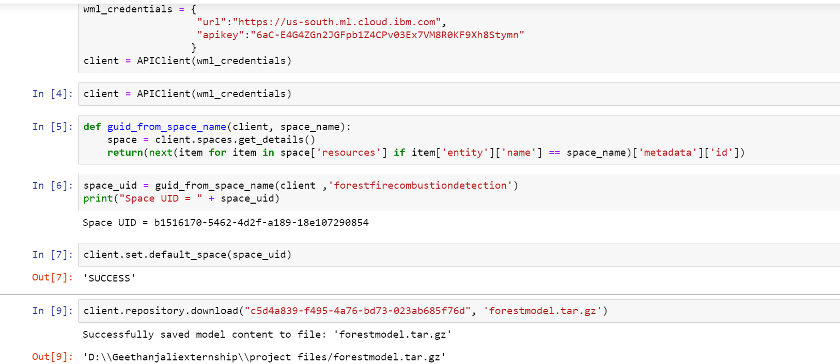

Slide 27
THANK YOU

